Slide 1

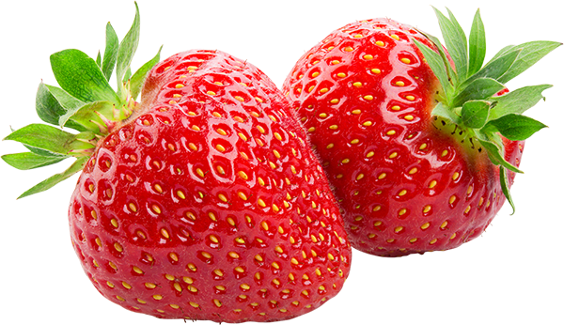
Molecular Nutrition
Work in Progress
Radhika Patel and Reilly Cashmore
6/29/2017

Slide 2
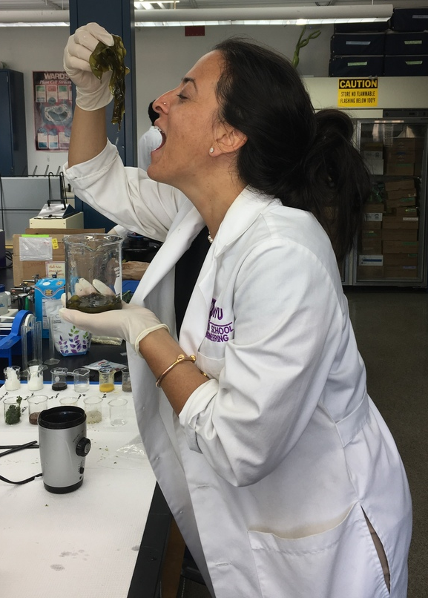
Overview
Objective
Background Information
Experiments
Test Results/ Conclusions
Difficulties
Improvements
Upcoming Tasks

Slide 3

Objective
Develop lab experiments for a Molecular Nutrition Course
Test different foods/supplements for nutritional info
Investigate health properties of different types of diets
Investigate the claims about raved “superfoods”

Slide 4
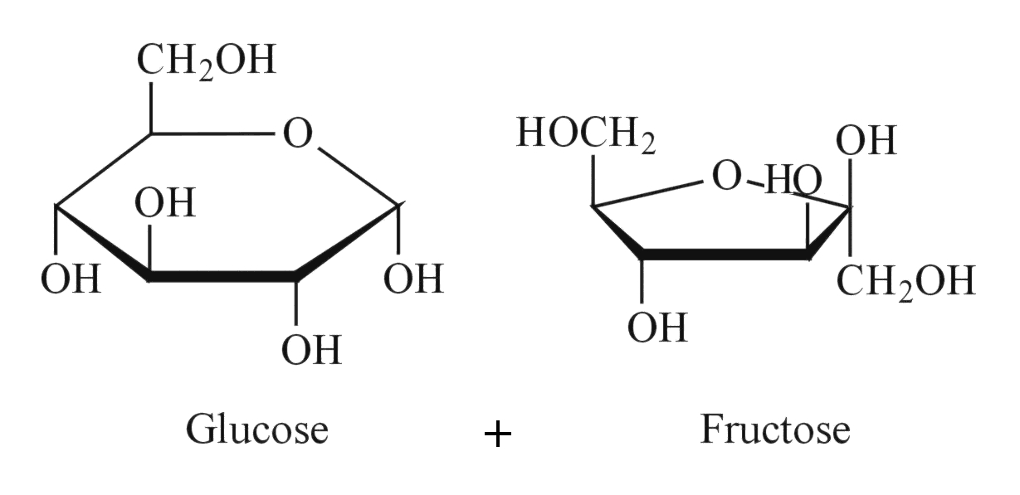
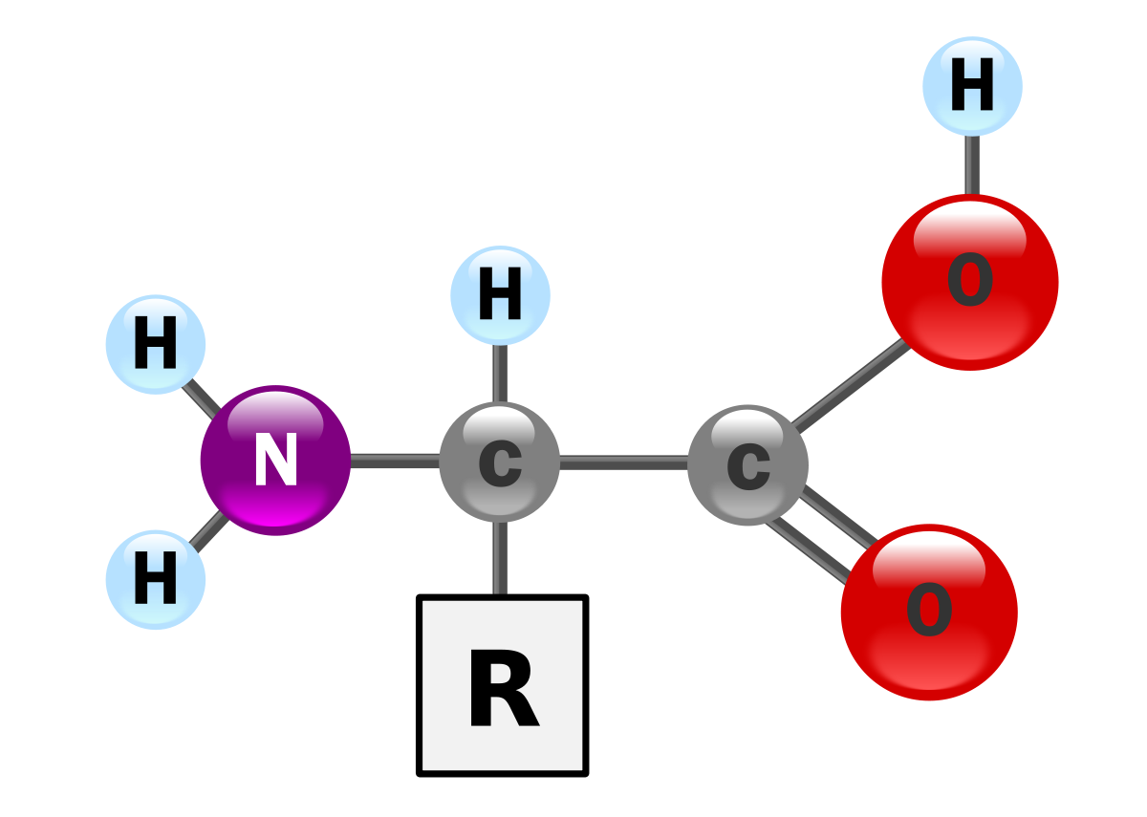
Background Information
Macro/micronutrients
Carbohydrates
Amino Acids
Vitamins
Minerals

Slide 5
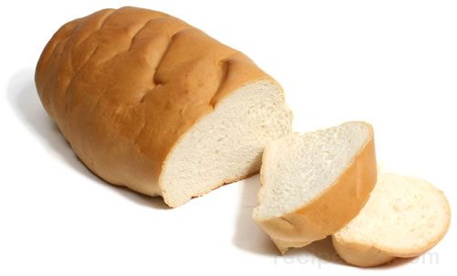
Carbohydrates
Glucose!
Available vs. Unavailable
available: broken down into monosaccharide in small intestine
unavailable: fermented in large intestine; forms fatty acids
Monosaccharides, Disaccharides, Polysaccharides

Slide 6
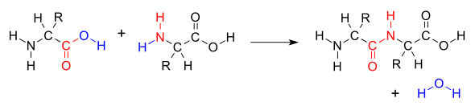
Amino Acids
Essential vs. Nonessential
20 common amino acids
9 of 20 are essential

Slide 7

Lab 1: Carbohydrates
Fehling’s Test: presence of reducing sugar
Benedict’s Test: presence of reducing sugar concentration
Barfoed’s Test: presence of reducing sugars (will have a thin film at the bottom of the test tube to indicate reducing monosaccharides)
Iodine Test: presence of polysaccharides
Bial’s Test: presence of pentoses and hexoses

Slide 8
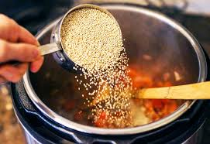
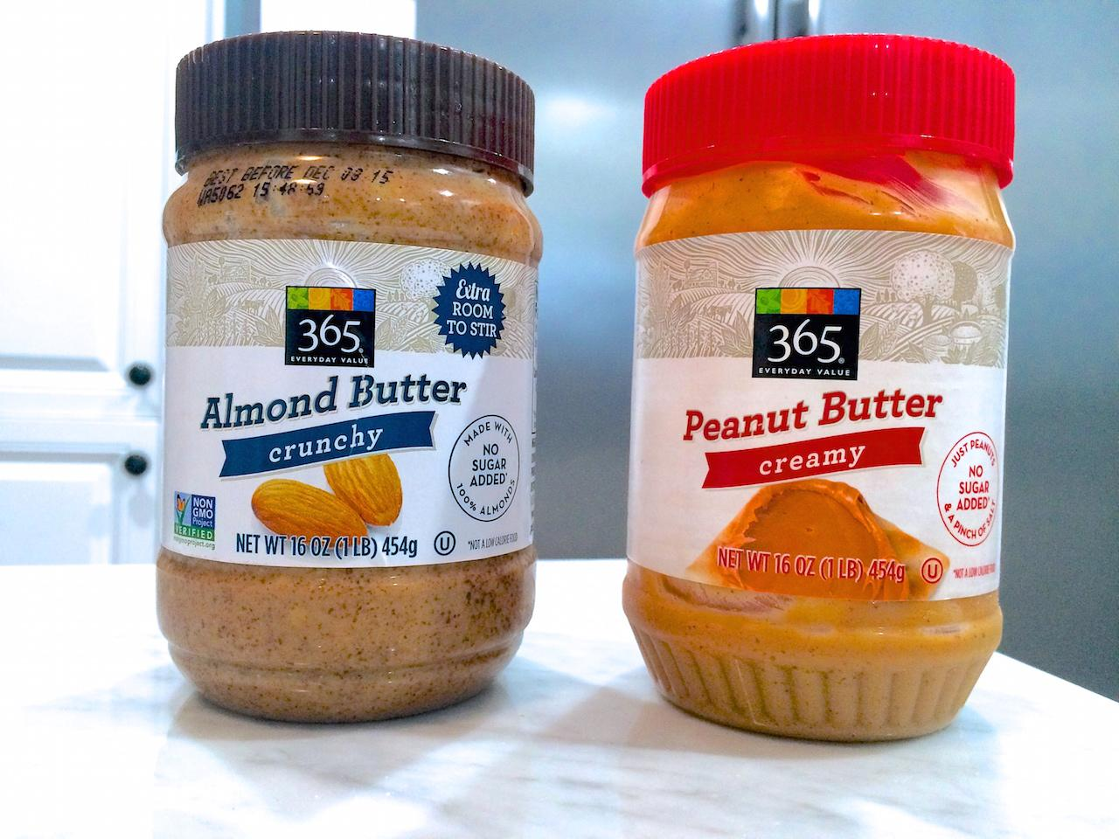
Lab 1: Carbohydrates
Items Tested:
Water
Green Tea
Vitamin Water
Coffee
Rice
Lentils
Quinoa
Blueberries
Protein Powder (plant-based)
Almond butter
Peanut butter
Seitan
Tofu
6/29/2017

Slide 9
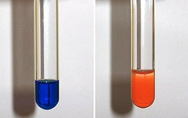
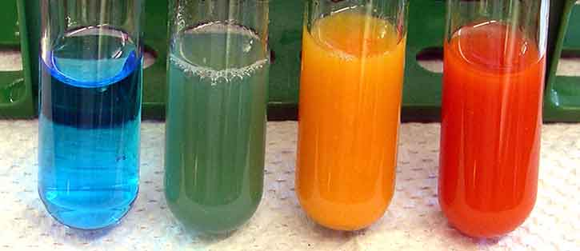
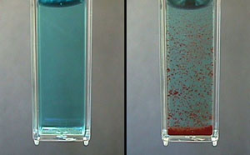
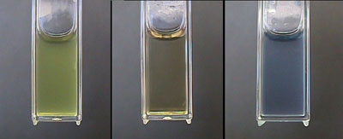
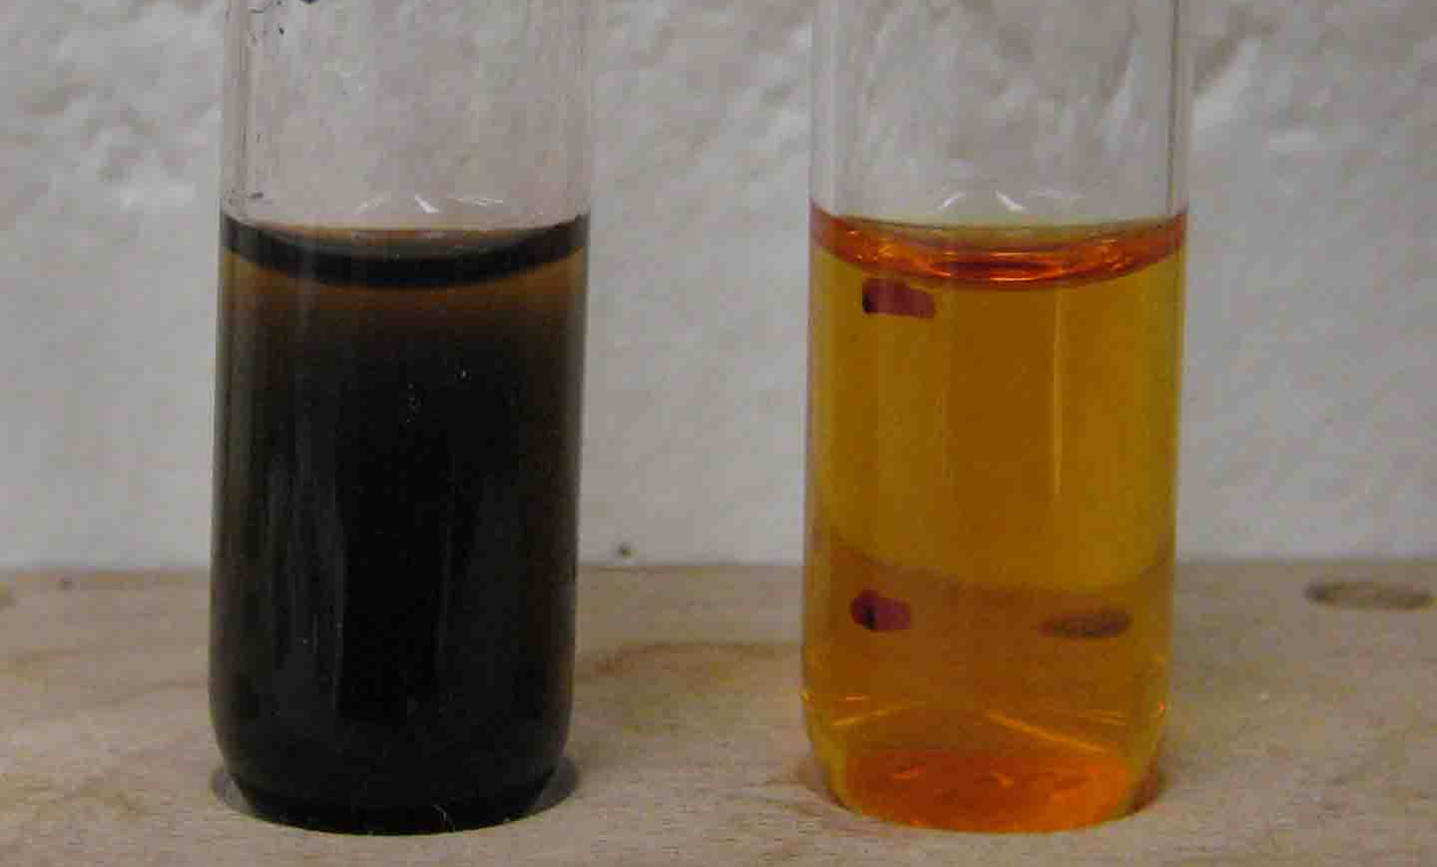
Expected Results for Lab 1
Fehling’s Test
Benedict’s Test
Barfoed's Test
Left: negative Right: positive
Left: negative, green: few sugars, yellow: some sugars, Right: positive
Left: negative Right: positive
Bial's Test
Iodine Test
Left: negative Middle: negative Right: positive
Left: positive Right: negative

Slide 10
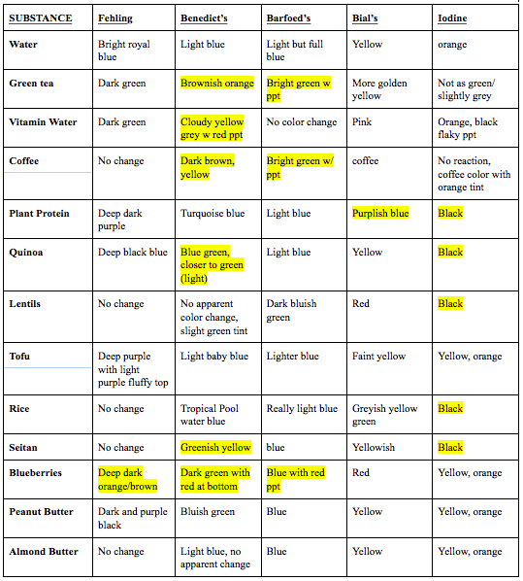
Experimental Results
KEY
= tested positive
6/29/2017

Slide 11
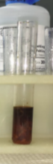
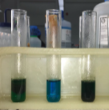
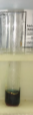
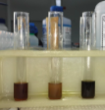
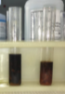
Conclusions about Lab 1
Fehling’s Test
(presence of reducing sugar)
Blueberries
Benedict’s Test
(presence of reducing sugar)
Green Tea
Vitamin Water
Coffee
Quinoa
Seitan
Blueberries
Barfoed’s Test
(presence of reducing sugar)
Green Tea
Coffee
Blueberries
6/29/2017

Slide 12
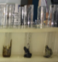
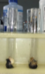
Conclusions about Lab 1
Bial’s Test
(presence of polysaccharides)
Plant Protein
Iodine Test
(presence of pentoses and hexoses)
Plant Protein
Quinoa
Lentils
Rice
Seitan
6/29/2017

Slide 13
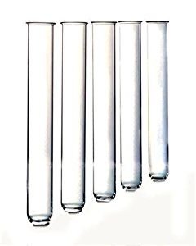
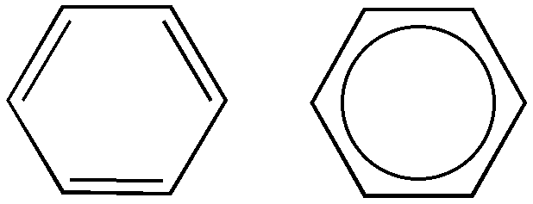
Lab 2: Amino Acids
Xanthoproteic Acid Test: presence of aromatic amino acids
Hopkins-Cole Test: presence of tryptophan
Lead Sulfide Test: presence of sulfur containing amino acids
6/29/2017

Slide 14
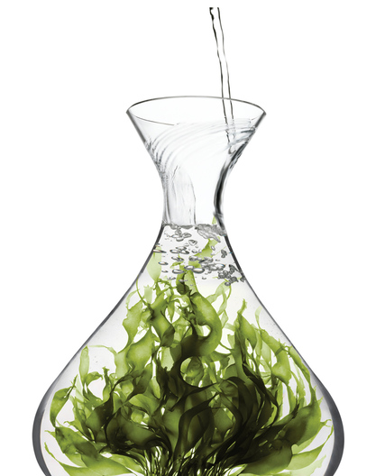
Lab 2: Amino Acids
Items Tested:
water
egg
annie chun seaweed
sea crunchy seaweed
arame
wakame
powder milk
greek yogurt
icelandic yogurt
hemp, flax, chia
spinach, kale
nutritional yeast
coconut oil
soy aminos
plant protein
peanut butter
almond butter
lentils
quinoa
brown rice
6/29/2017

Slide 15
Test Results for Lab 2
 | Xanthoproteic | Hopkins Cole | Lead Sulfide
Water | Clear | Clear | White ppt
Annie Chun Seaweed | Light yellow | Very small faint yellow ring | Light green w/ white ppt
Sea Crunch Seaweed | Greenish-yellow (like annie Chun) | Dark green with very small faint yellow ring | Brighter green w/ slight white ppt
Arame Seaweed (looked potentially burnt) | Orange | yellow | Ppt formation
Wakame Seaweed | yellow | Thick green/difficult to determine a ring formation | White ppt formation
Hemp Seed | (Burnt) orange-y yellow | Deep purple thick ring | White ppt formation
Milk powder | Bright yellow, like an egg | Peachy pink(no visible particles) with a red-orange ring | Potential white ppt formation/ iodine coloring
Flax seed | yellow | Peachy ring | A little white ppt
Spinach | Greenish yellow | Dark dark green | Very little white ppt on surface
 | Xanthoproteic | Hopkins Cole | Lead Sulfide
Kale | Completely unrecognizable/ turned to a bright yellow substance | Dark dark green | Virtually no white ppt, evidence of burning on bottom
Egg | Looks cooked, yellow | Deep purple thick ring | Turned brown with white ppt
Chia | Yellow | Peachy ring formation | A lot of white ppt
Nutritional Yeast | No apparent color change | Reddish ring formation | Very very little ppt/ could just be yeast grain
Coconut Oil | No change | Slight faint yellow ring formation | White ppt formation
Soy Aminos | No change | No detectable change, but original color was already dark. When h2so4 added, the tube fizzed and popped a bit | White ppt formation
Greek Yogurt | Bright yellow | Thick dark Purple ring | White ppt, yogurt turned brown
Icelandic Yogurt | Bright yellow | Peachy ringn | White ppt, yogurt turned brownish

Slide 16
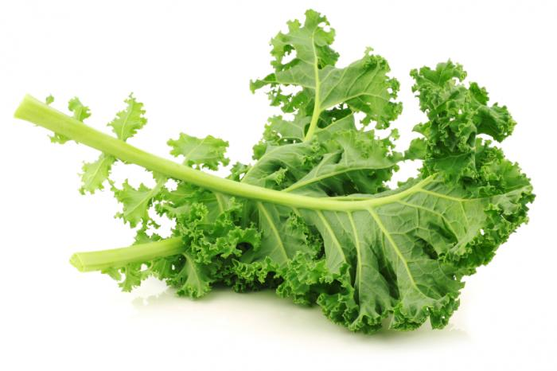
Conclusions about Lab 2
High Performing
Yogurts
Kale
Seeds
Low Performing
Coconut Oil
Soy Aminos
Nutritional Yeast
Improvements
More reagent, less substance
Better liquidation methods
6/29/2017

Slide 17
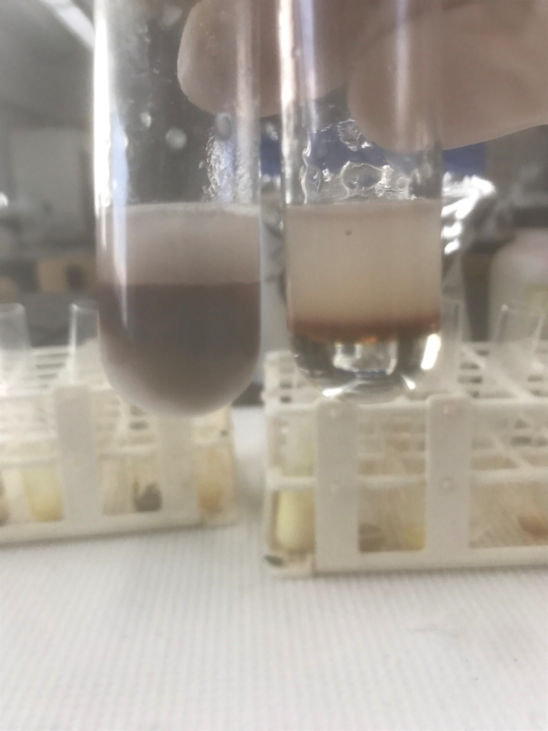
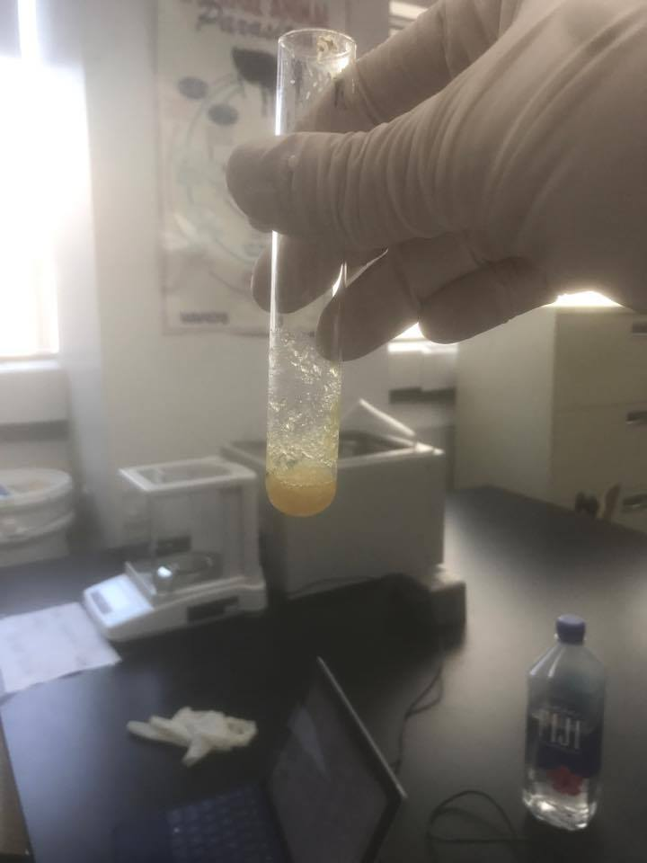
Test Results
Greek yogurt Icelandic Yogurt
Hopkins-Cole
Kale
Xanthoproteic Acid

Slide 18
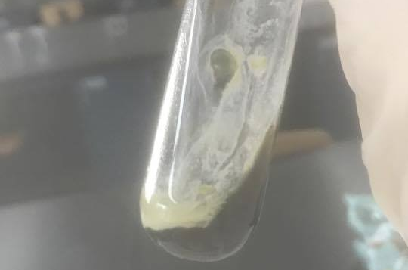
Test Results
Wakame Seaweed
Lead Sulfide

Slide 19
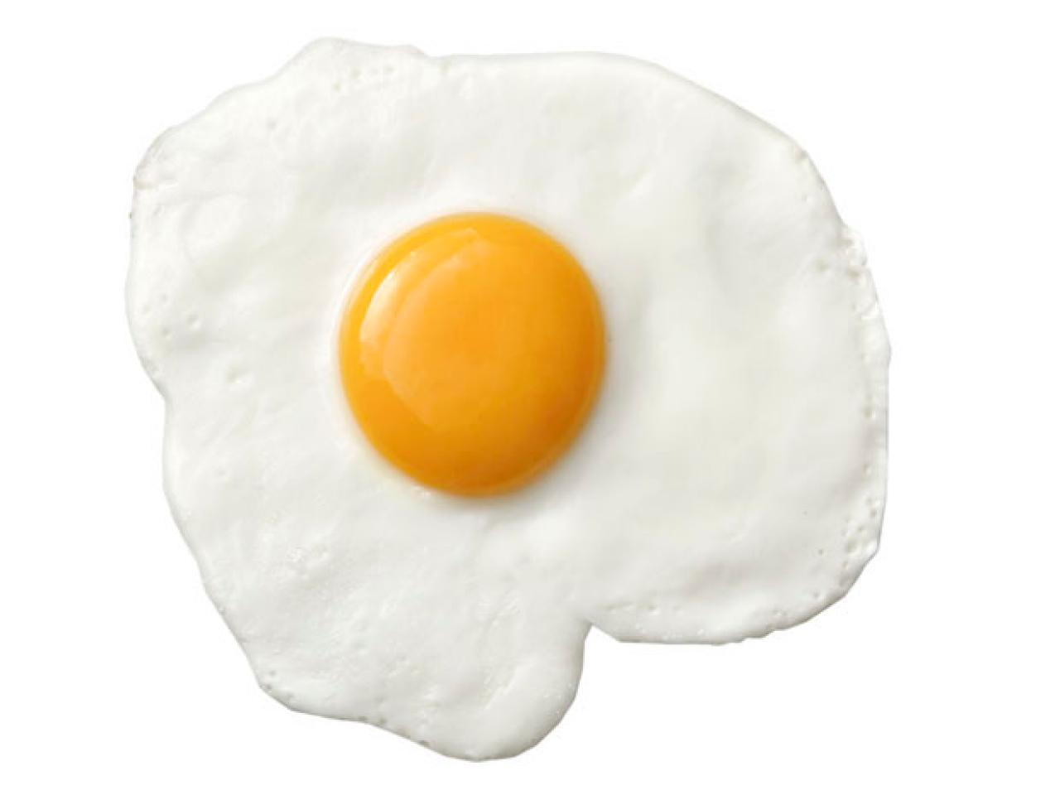
Difficulties
Did not have all the reagents
Testing dry vs. wet substances
Testing solid vs. liquid substances
Overall reagent preparation
Cooked/burnt substances

Slide 20
Improvements
Uniformity in lab experiments: Repeatability
Less is more! (Less substance, more reagents)
Organization of results
Trying to make Qualitative tests instead of Quantitative tests

Slide 21
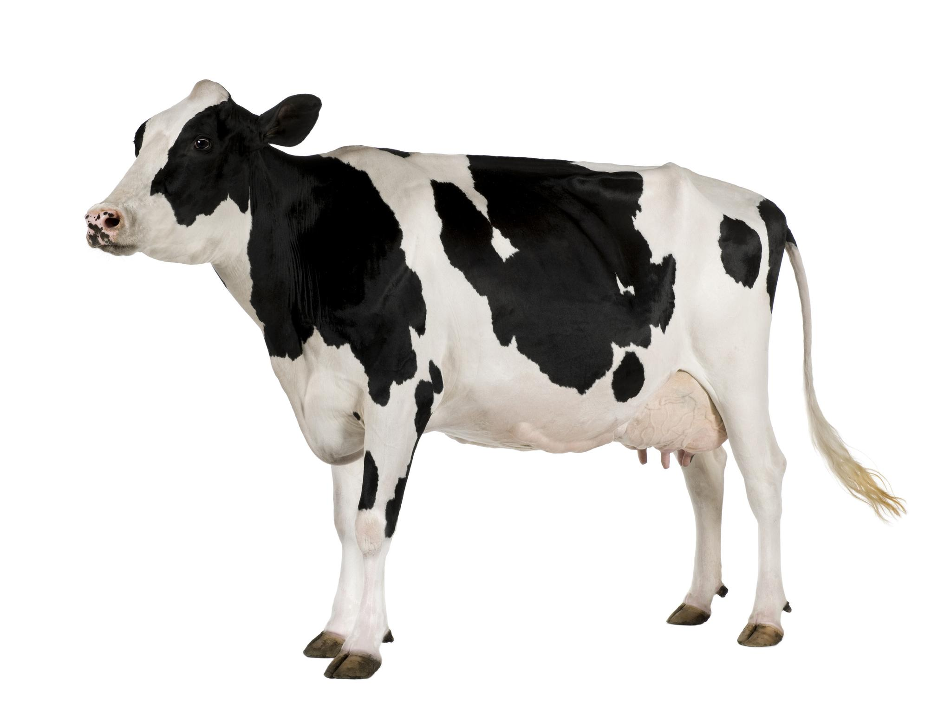
Upcoming Tasks
Rest of Qualitative Analysis of Amino Acids
Adulterations in Milk Lab
Casein Extraction Milk Lab
Develop and implement Vitamin B lab
Develop and implement activated charcoal tests
Develop and implement chlorella tests

